Slide 1
FunTravel
1

Slide 2
Table of contents
01
User interviews
02
Personas & scenarios
03
Prototype
04
Thinking aloud
2

Slide 3
Why FunTravel?
Safe place for your children where they will not be bored during the travelling and can learn something new.
3

Slide 4
User interviews
9 children
Age: 6 -12 years
Average age: 9,7 years
4

Slide 5
User interviews
5
Notes:
Car: 55%
Bus: 55% train: 22%
100% are having IPad
The most children are watching videos in youtube or play pre-downloaded games

Slide 6
User interviews
Used by children:
Desired by parents:
- Multiplayer games
- Games: Angry birds, Fruit Ninja
- Reading short stories
- Counting games
- Reduce gaming duration
- Learn something new
- More interaction with the adults
- Games for siblings to play together
6

Slide 7
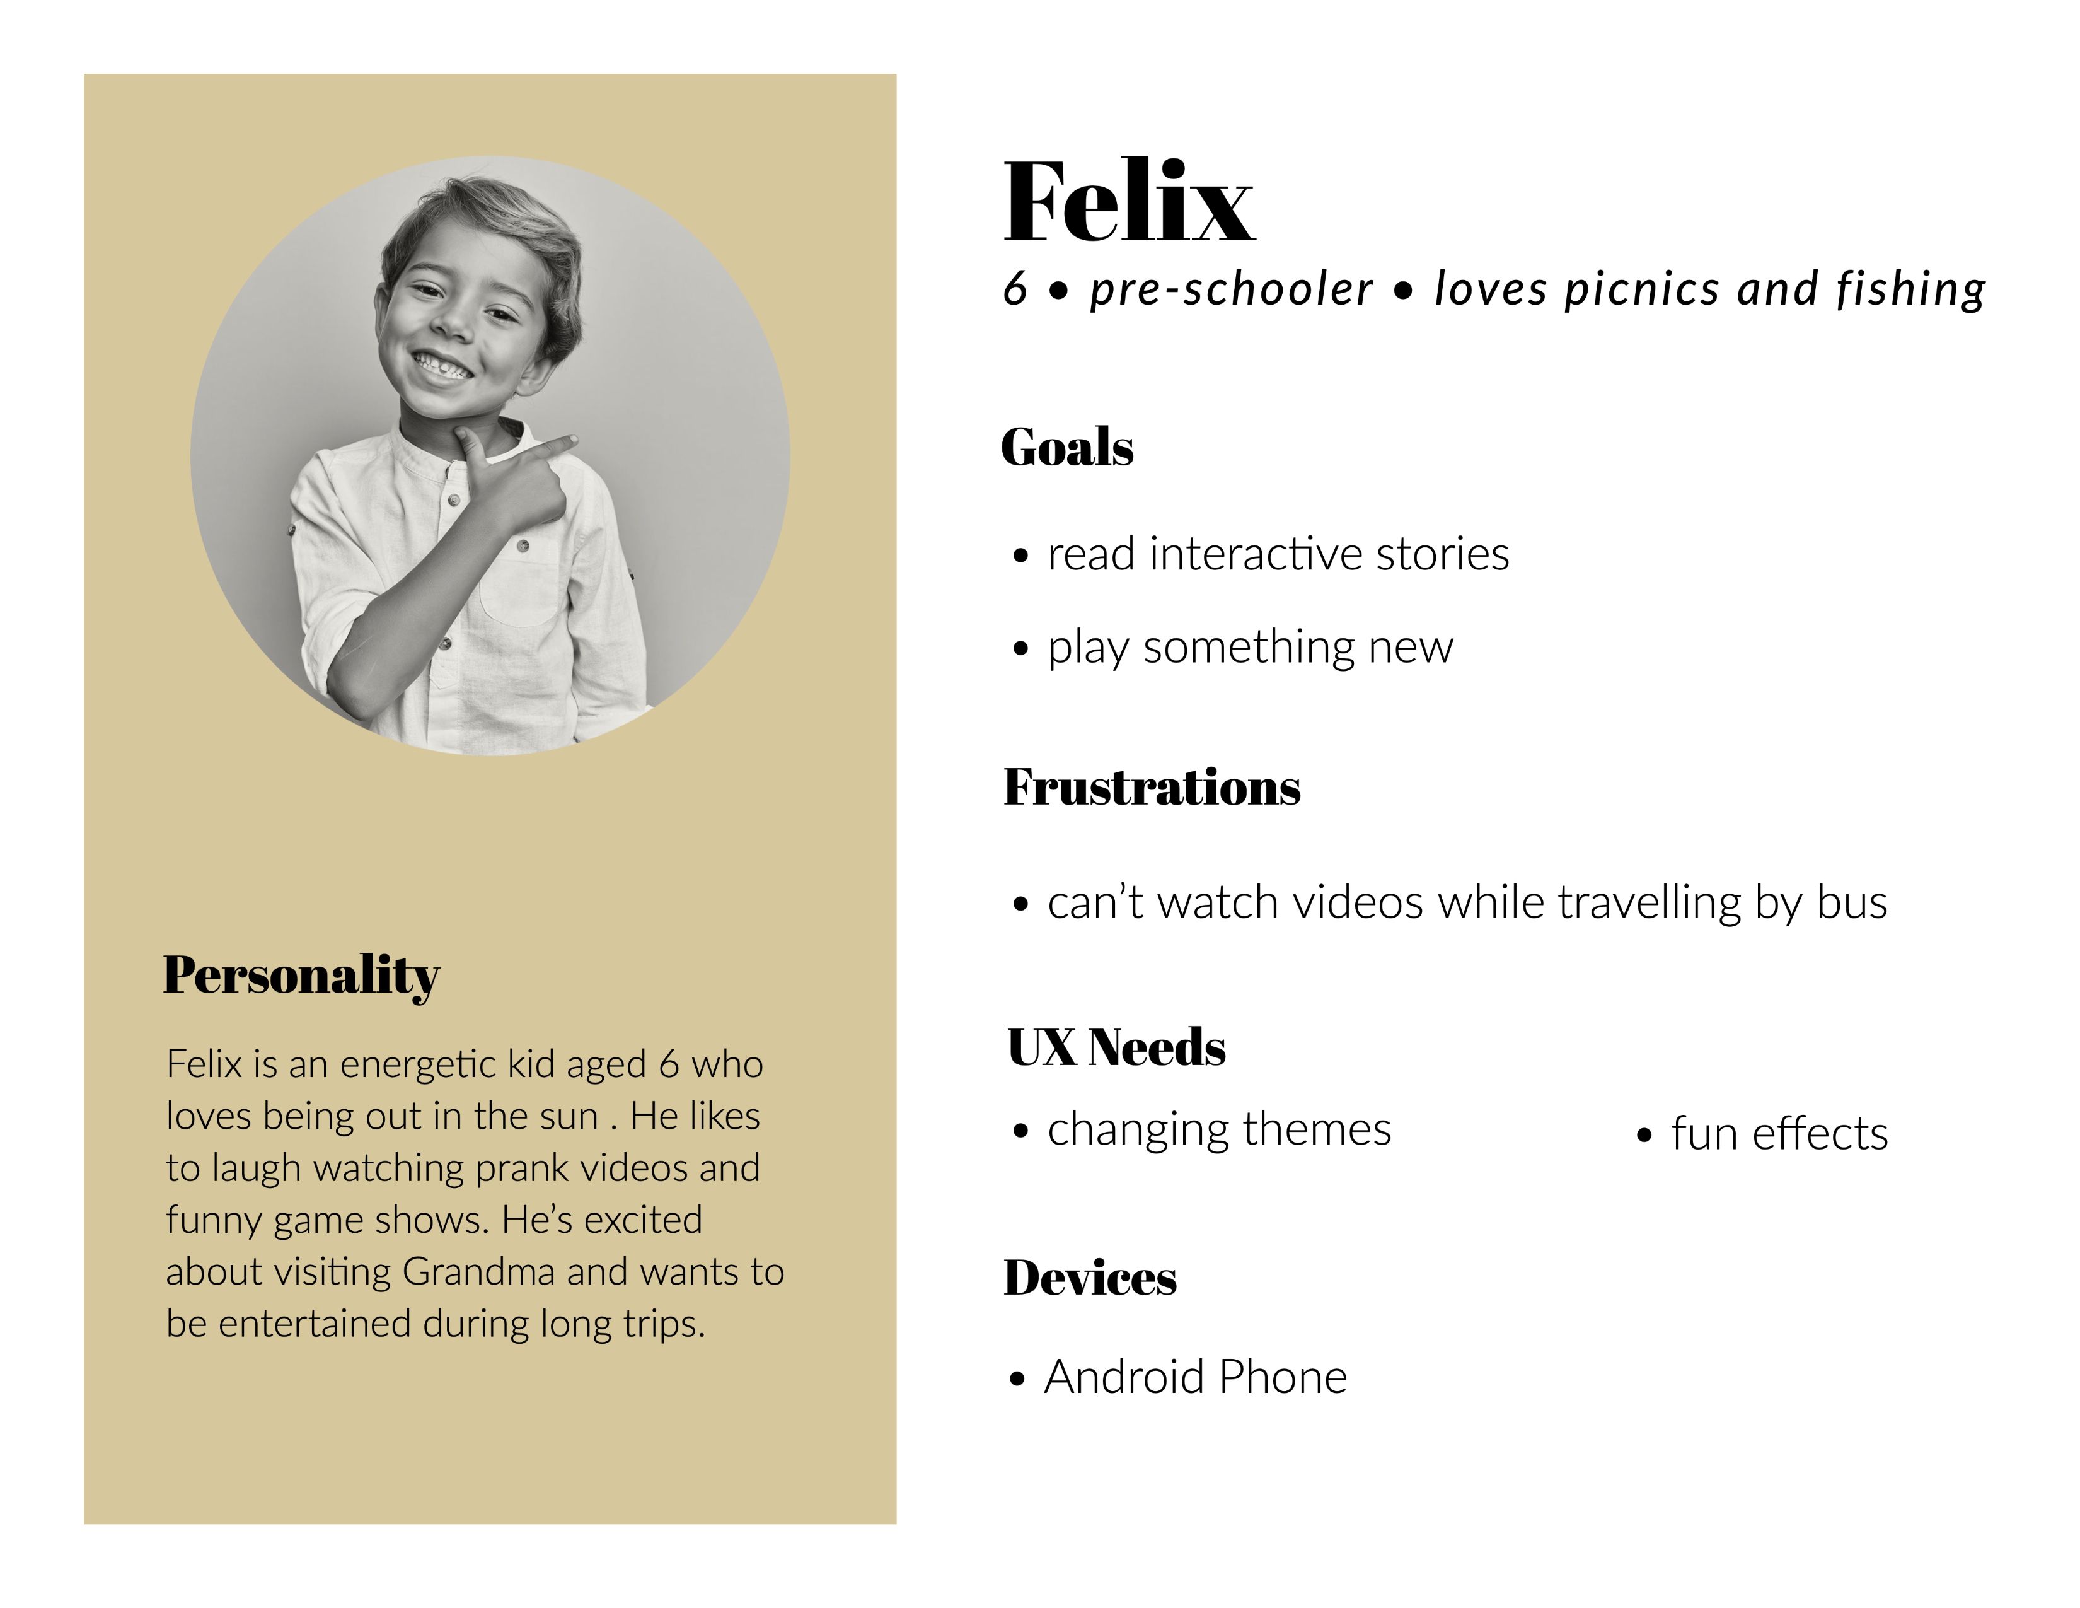
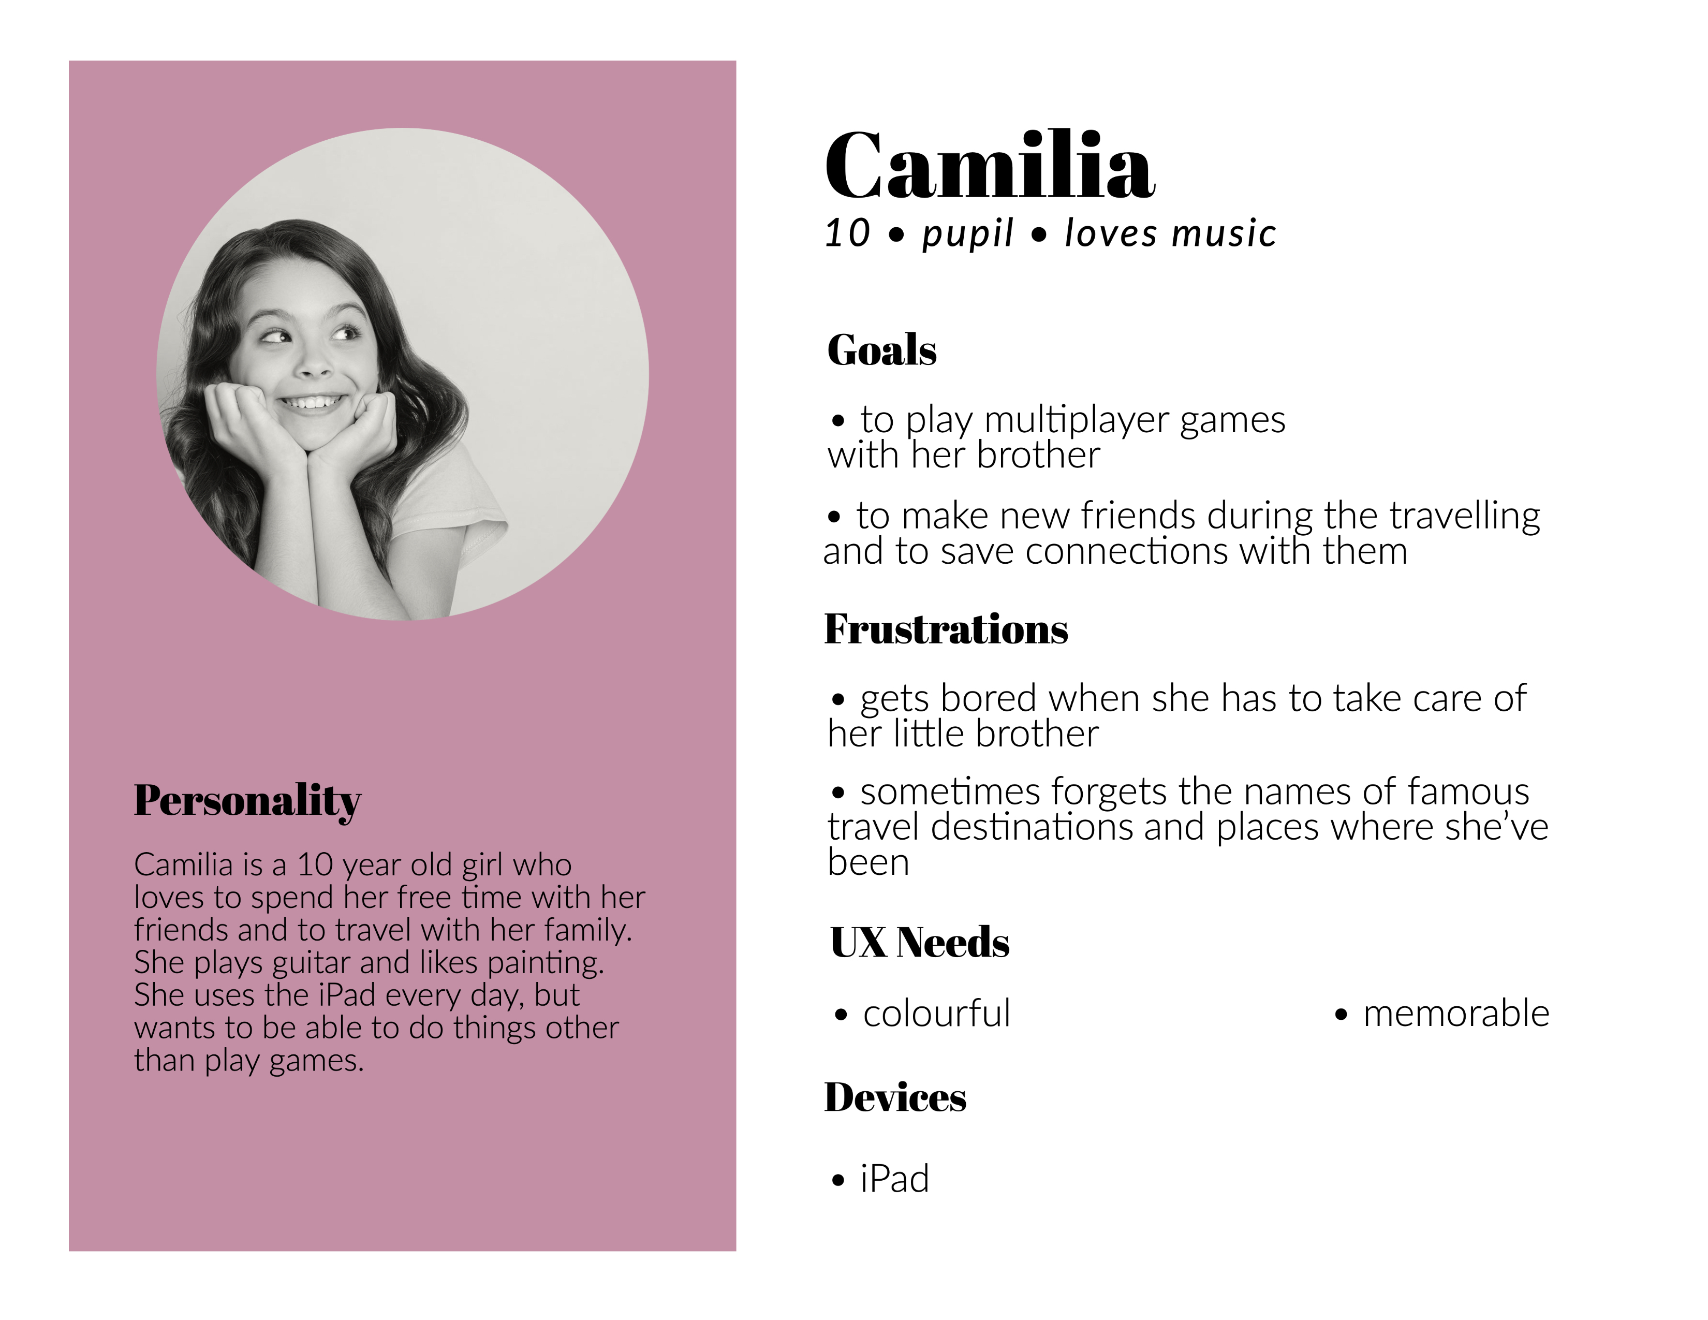
Personas
7

Slide 8
Scenario - Felix
As a suburban kid, Felix never misses an opportunity to visit his grandmother, who lives in a quiet village 200 miles away. Although the prospect of meeting his grandmother excites him, he doesn’t like to sit in the bus for hours.
Due to poor signals and limited data connection he can’t watch his favourite shows. He wants to play some new funny games to kill the time during the driving. He likes to play something funny with lots of different sounds.
Felix wants to bring some stories on his own too but he doesn’t know any new stories. He wants to have all these options in a single app as he can’t download multiple apps without assistance and wants different stories based on the season he is in.
Besides all the new adventures awaiting at the village the moon-watching and storytelling sessions with his grandparents is something he looks forward to.
8

Slide 9
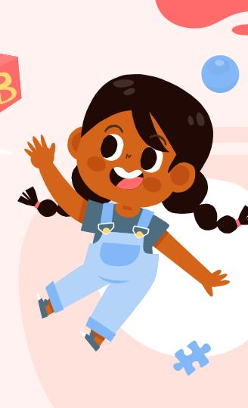
Functionality
Play games
Create memories
FunTravel
Watch videos
Share everything with your friends
Read books and stories
Take pause after games
9

Slide 10
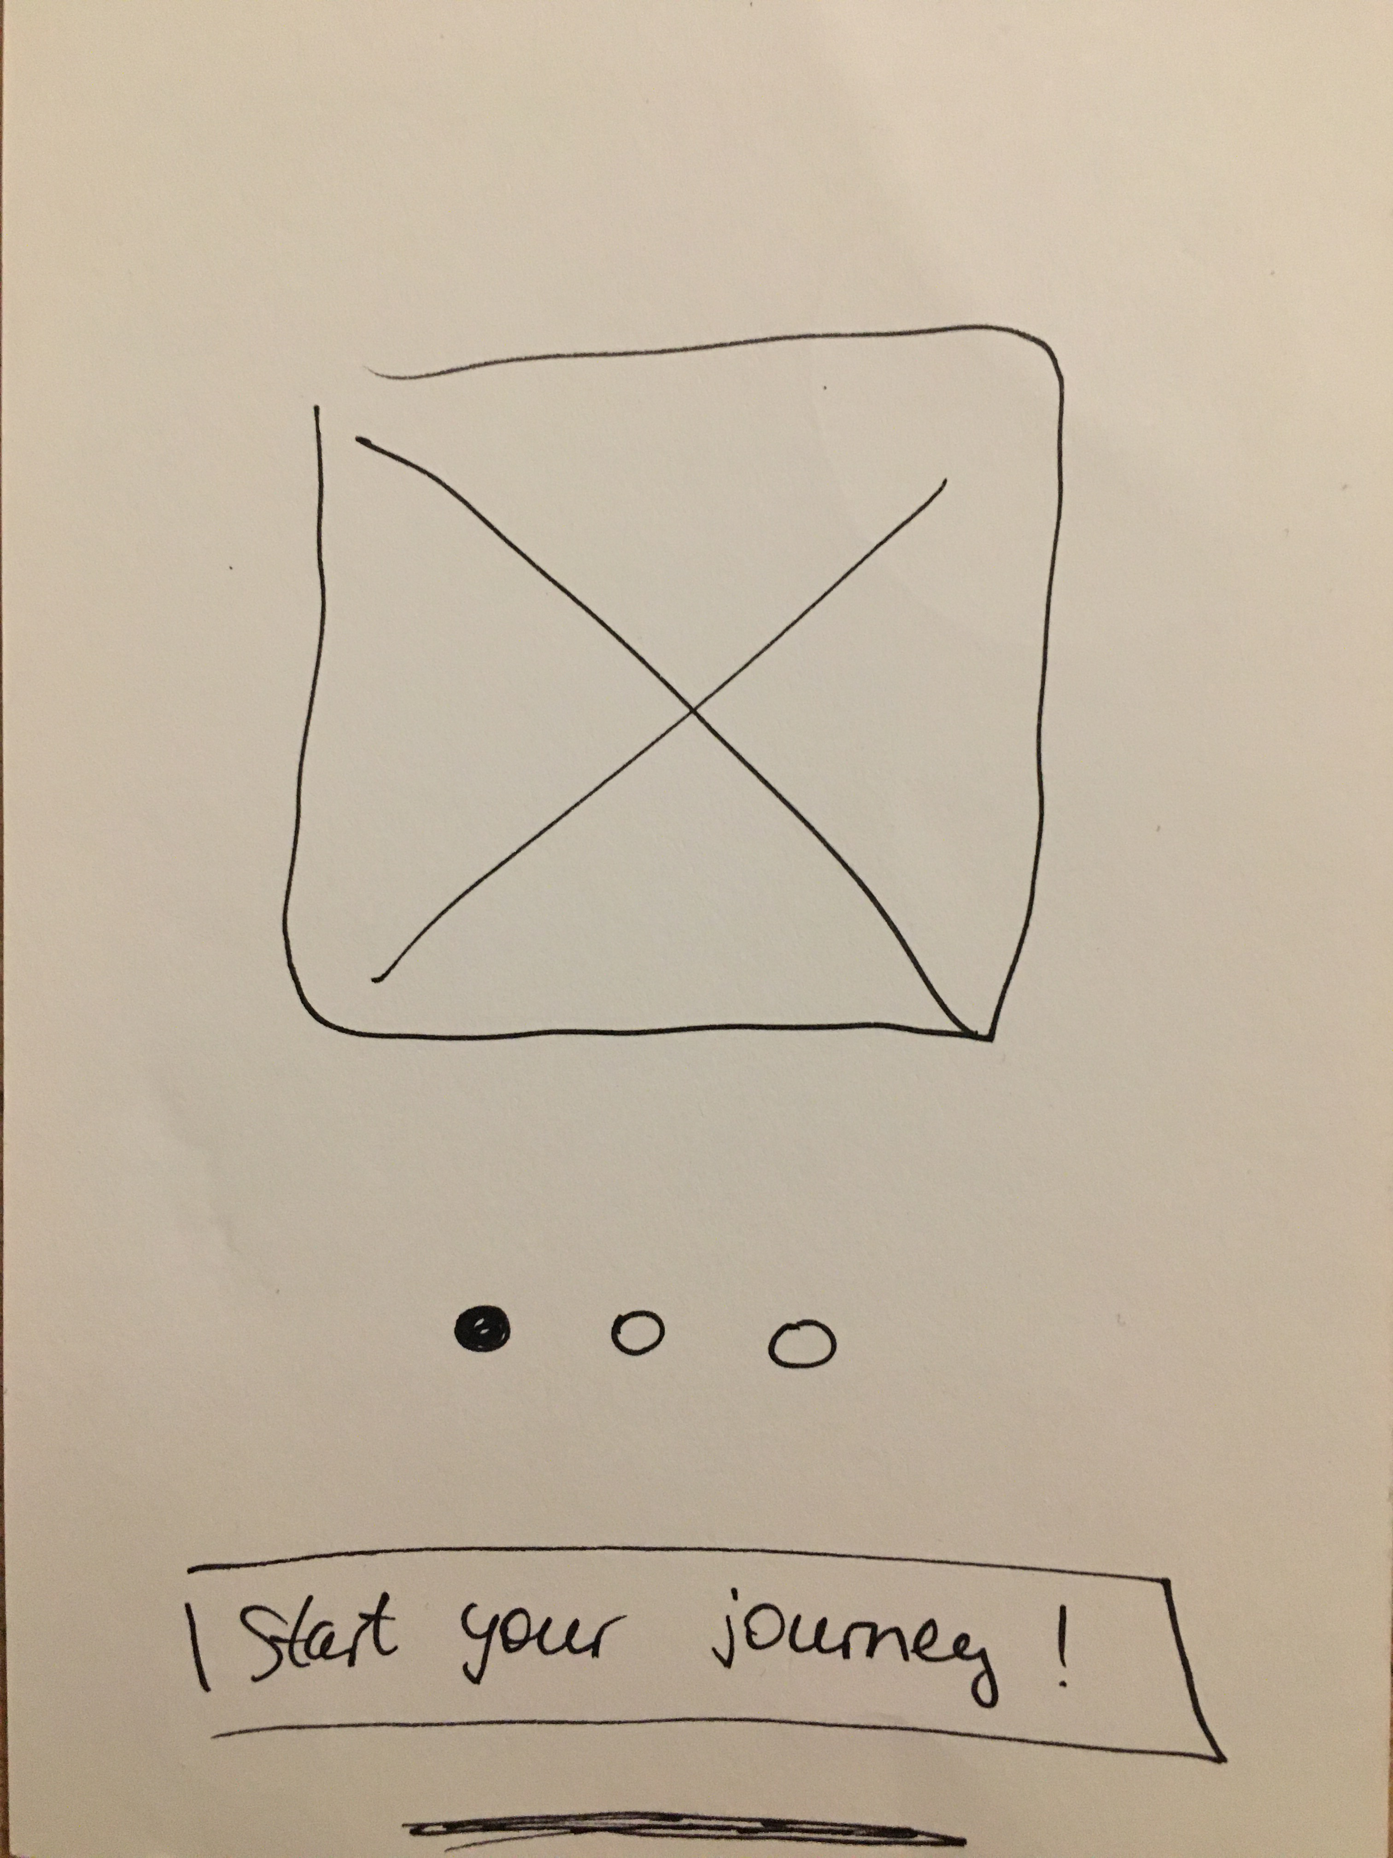
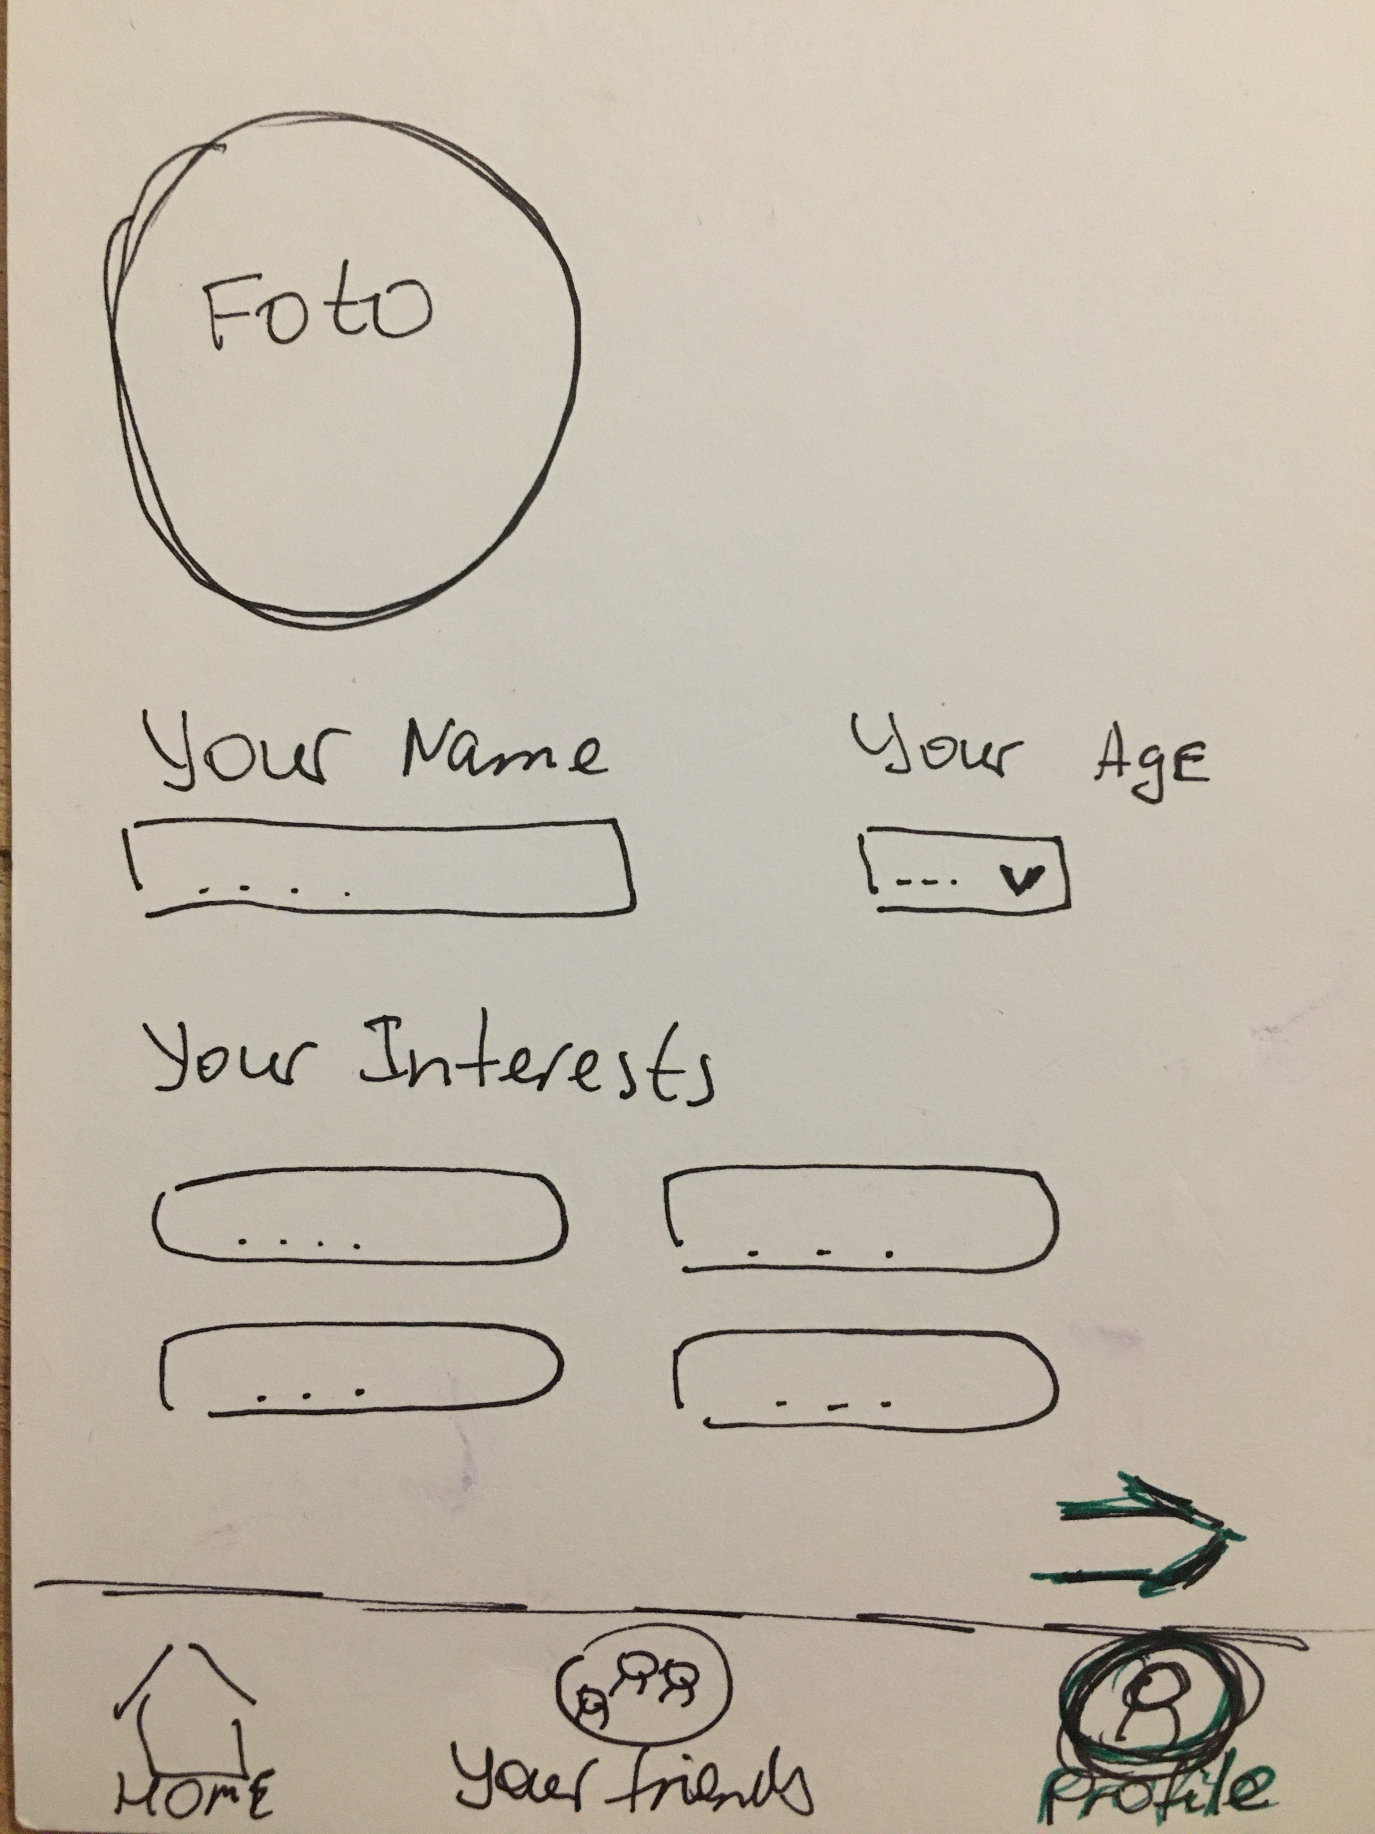
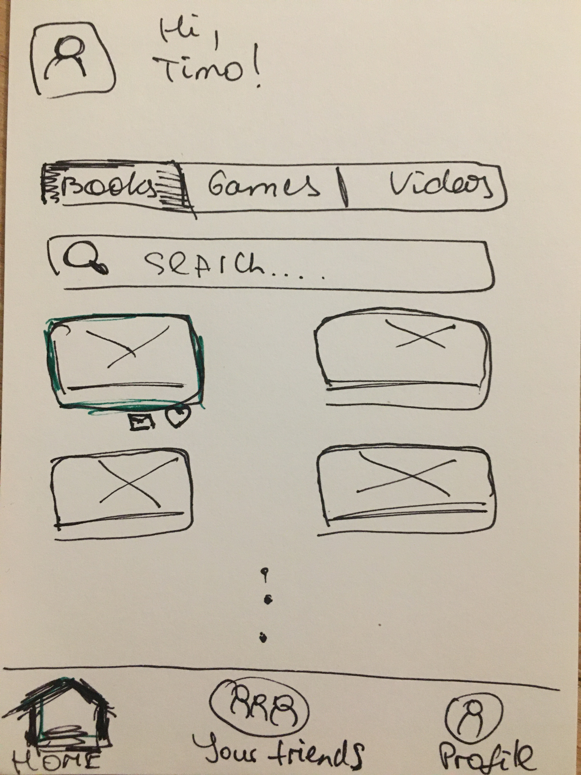
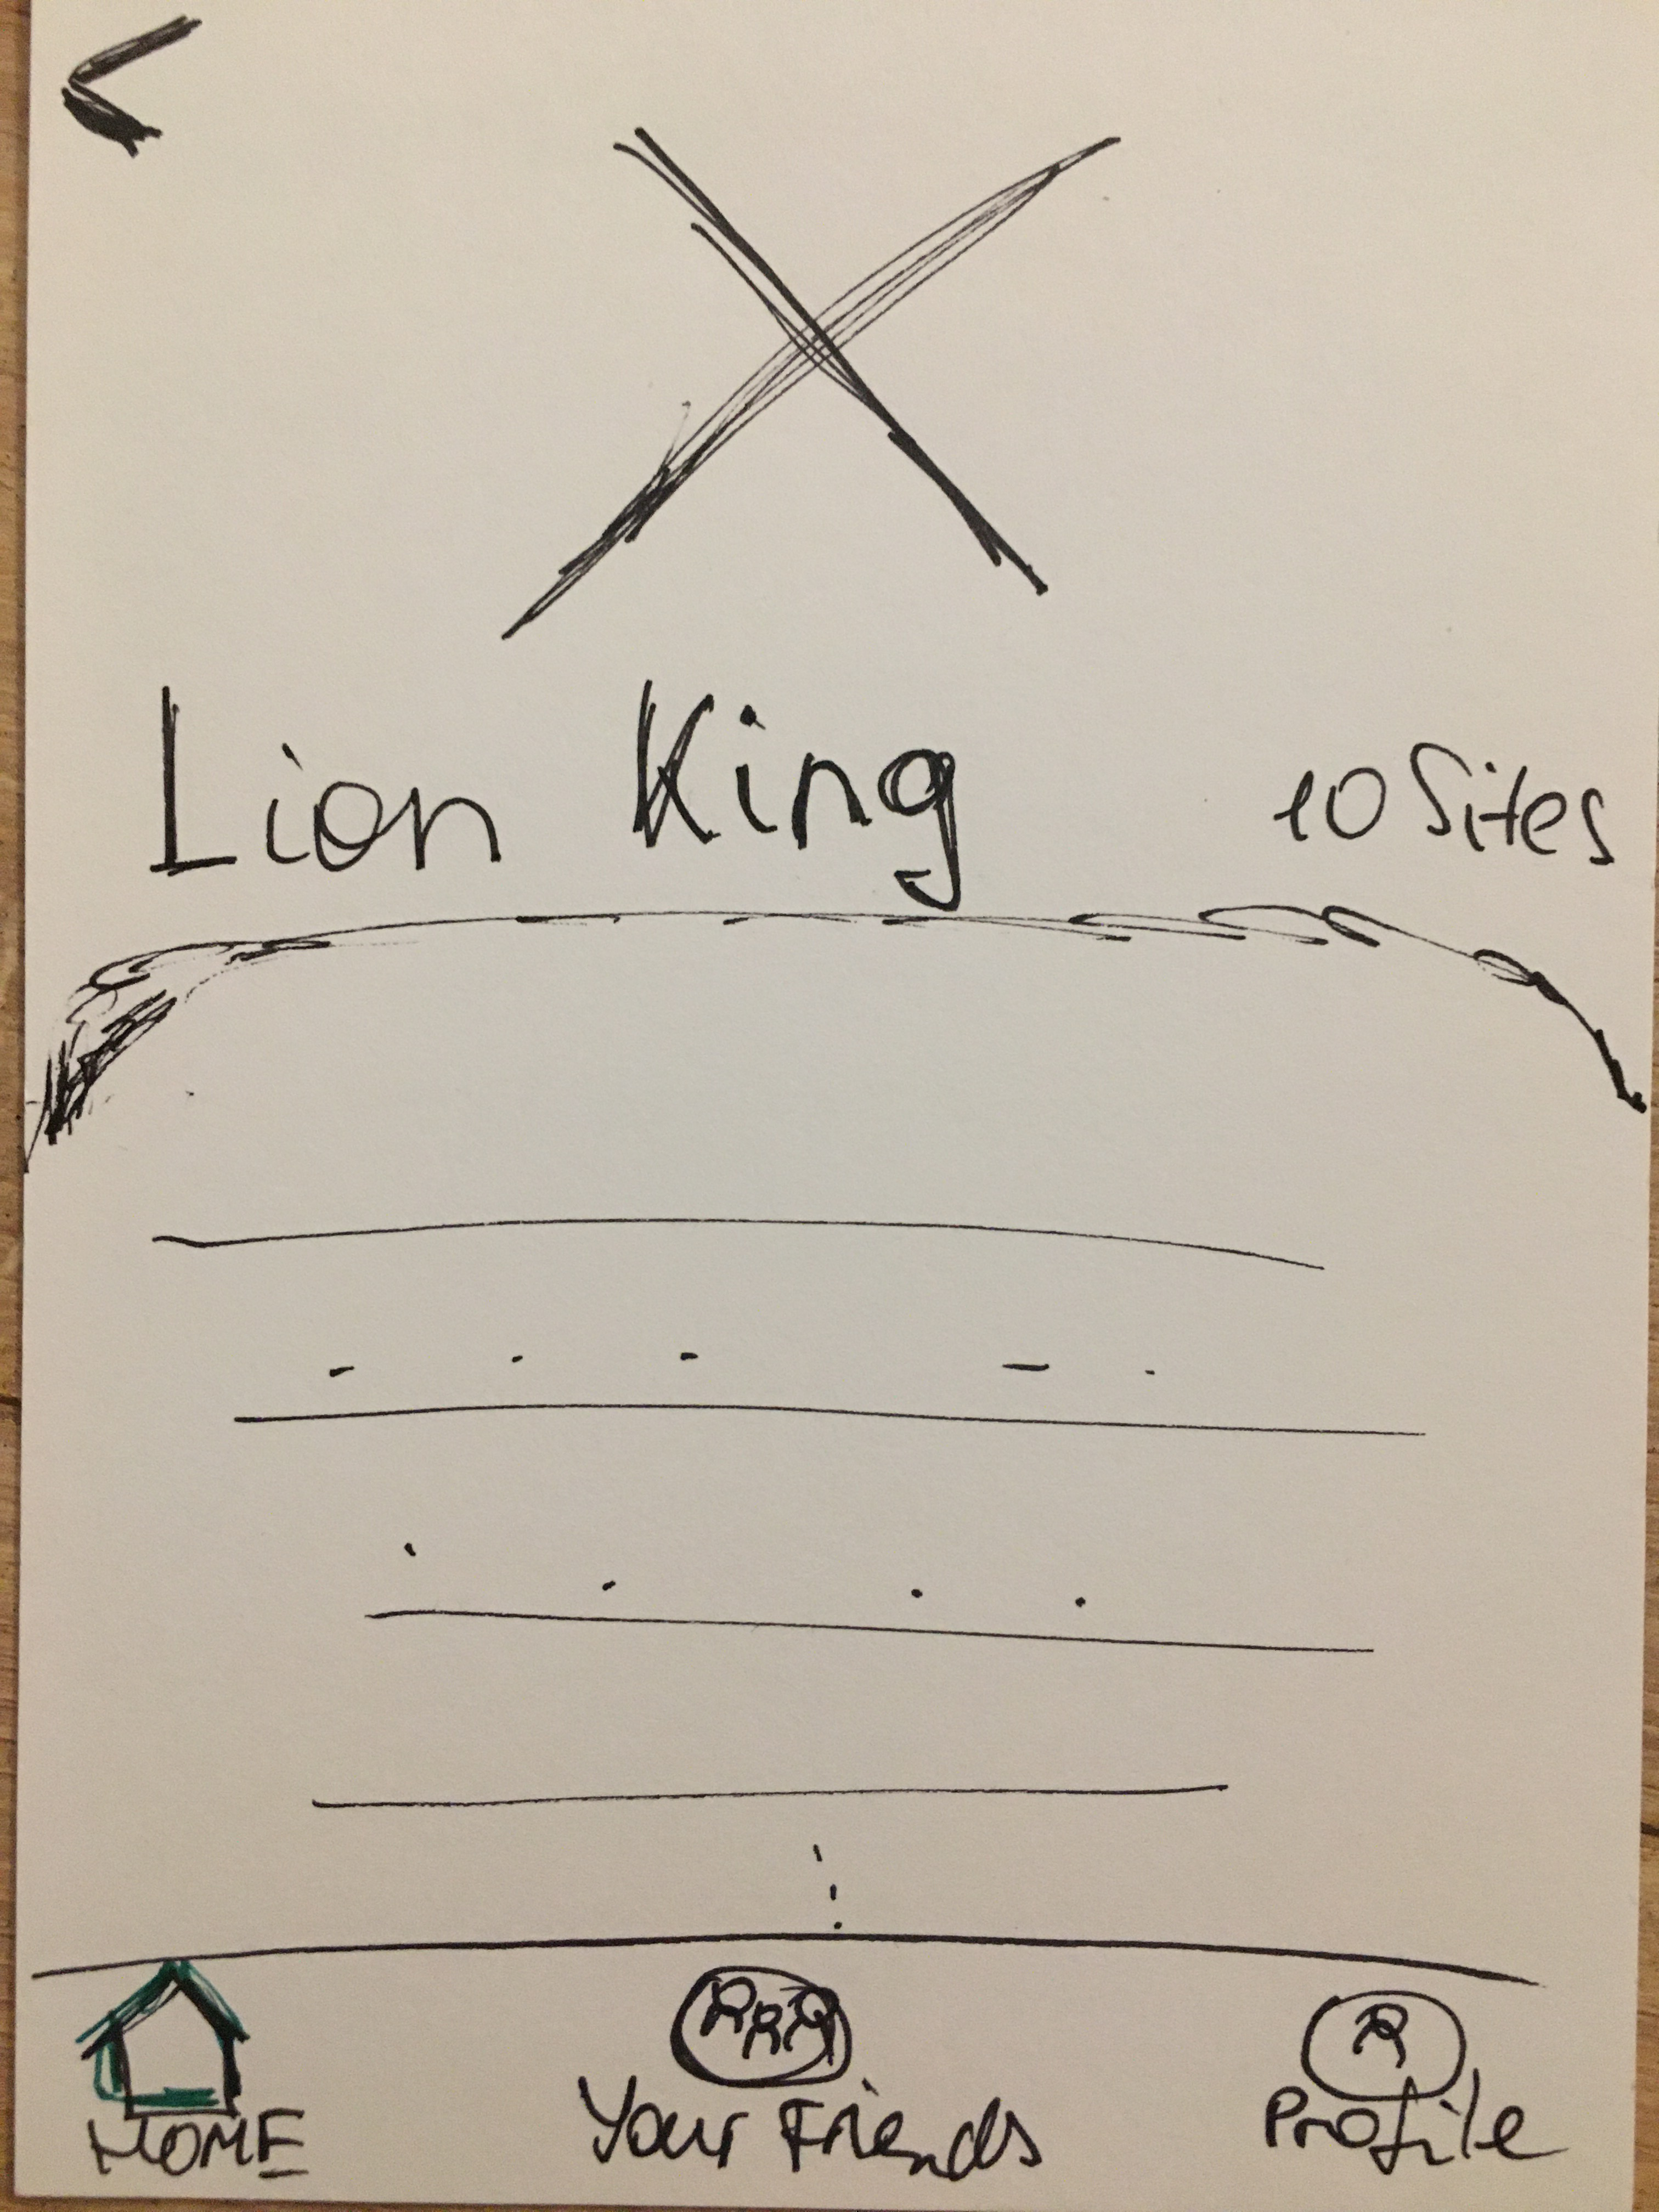
Prototype
Onboarding & Login
Reading
10

Slide 11
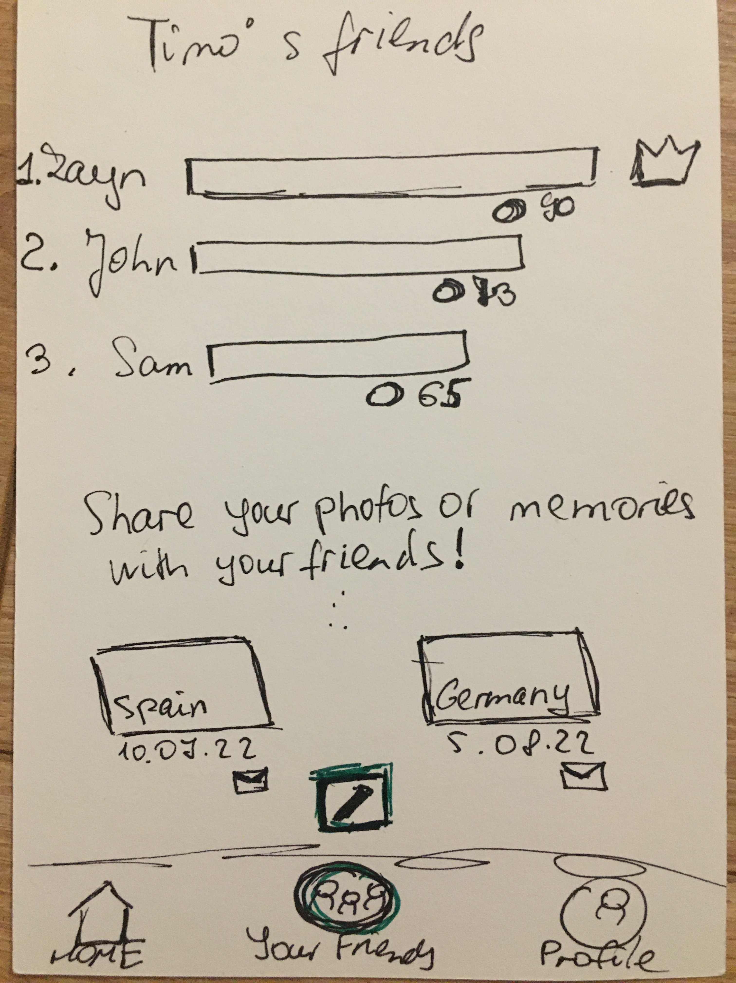
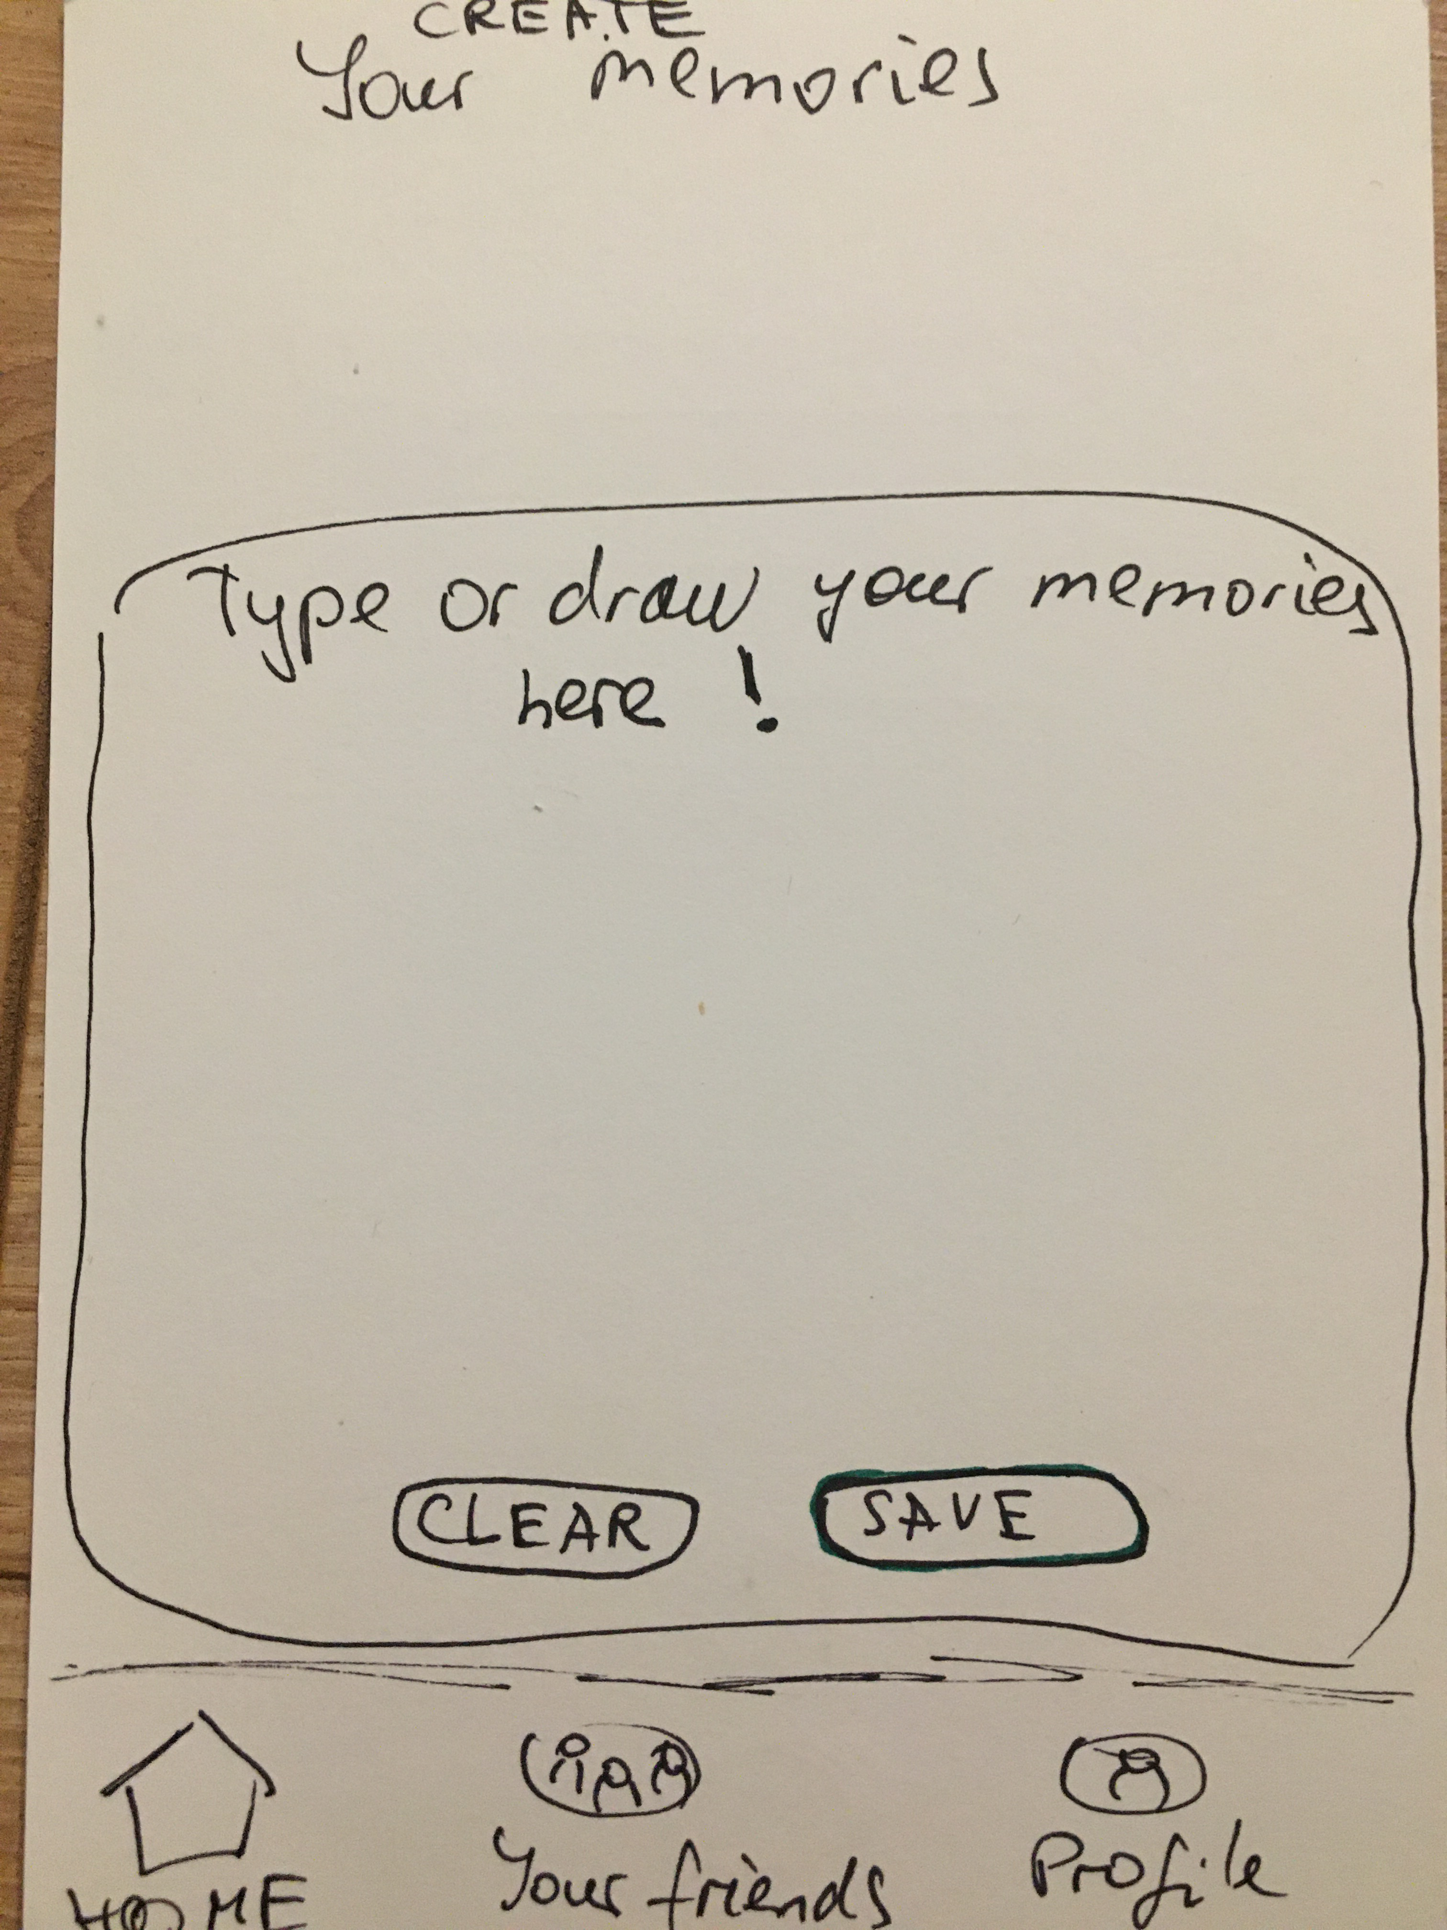
Prototype
Friends and memories
11

Slide 12
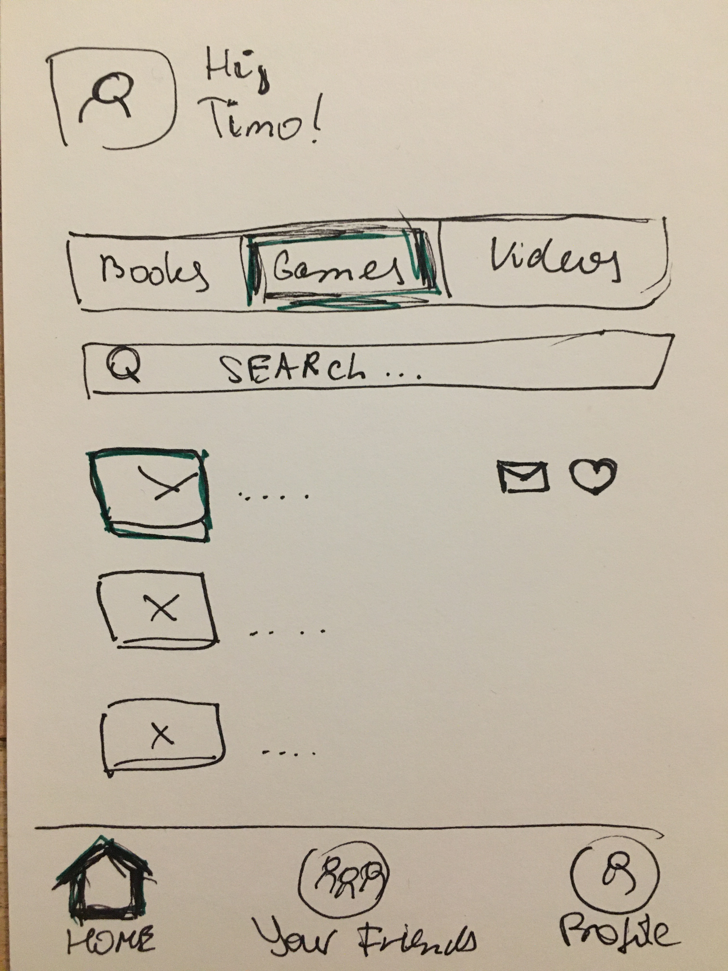
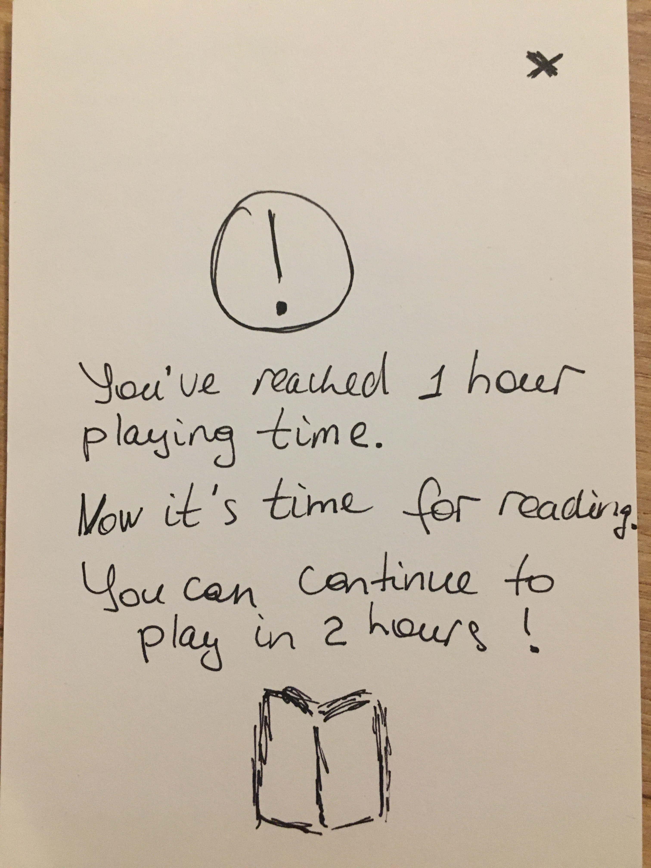
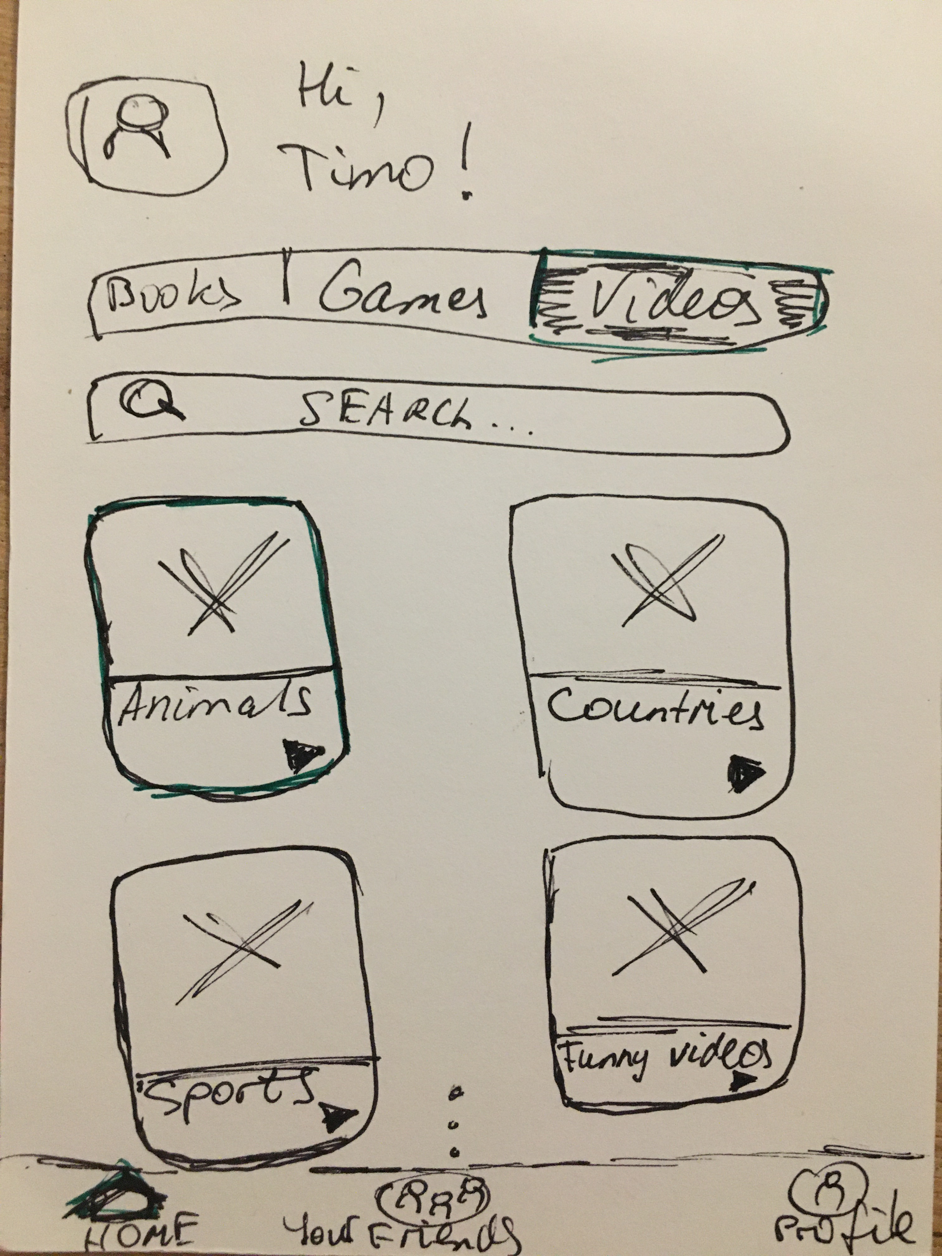
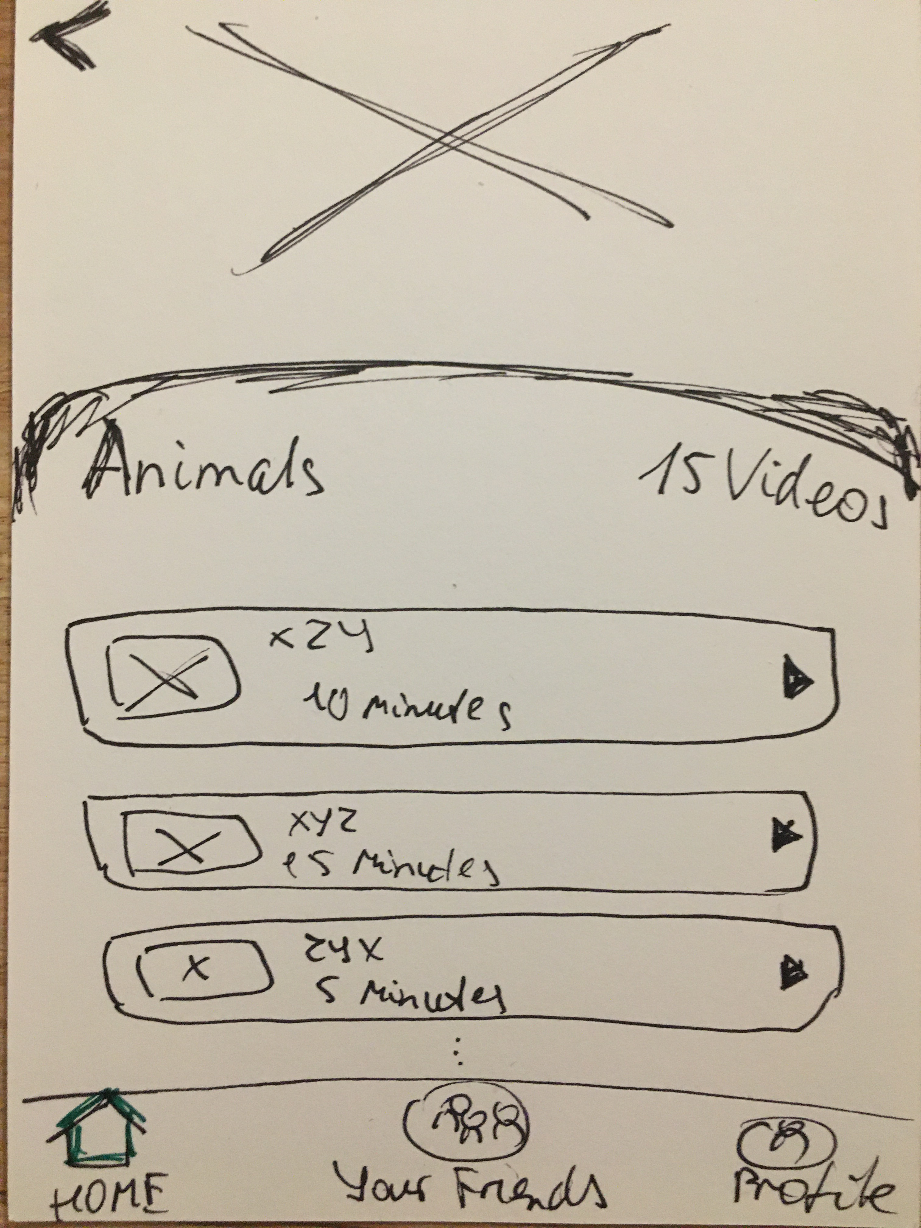
Prototype
Playing games
Watching videos
12

Slide 13
Thinking aloud
Improvements:
Average time complexity: 1,75
Average satisfaction: 3,5
Average clarity (Interface UI): 4,5
5 children
- Providing beginners guidance for the user who opens this app for the first time;
- Personal settings for the users, such as personal recommendations;
- Image editing function in diary function, and still need more options in hand-writing diary part;
- Function to add other friends via address book or same interests;
13
Notes:
Most of the users find that the graphic interface of the app are easy to recognize and the functions that this app offers are pretty clear for them, and as for the time complexity, they think it would be better that the app could proivide personal recommandations in the searching videos/games/books function. Moreover most of the user are satisfied with this app but they still think this app cannot replace their existing apps as whatsapp or instagram.

Slide 14
Thank you for your attention!

